Slide 1
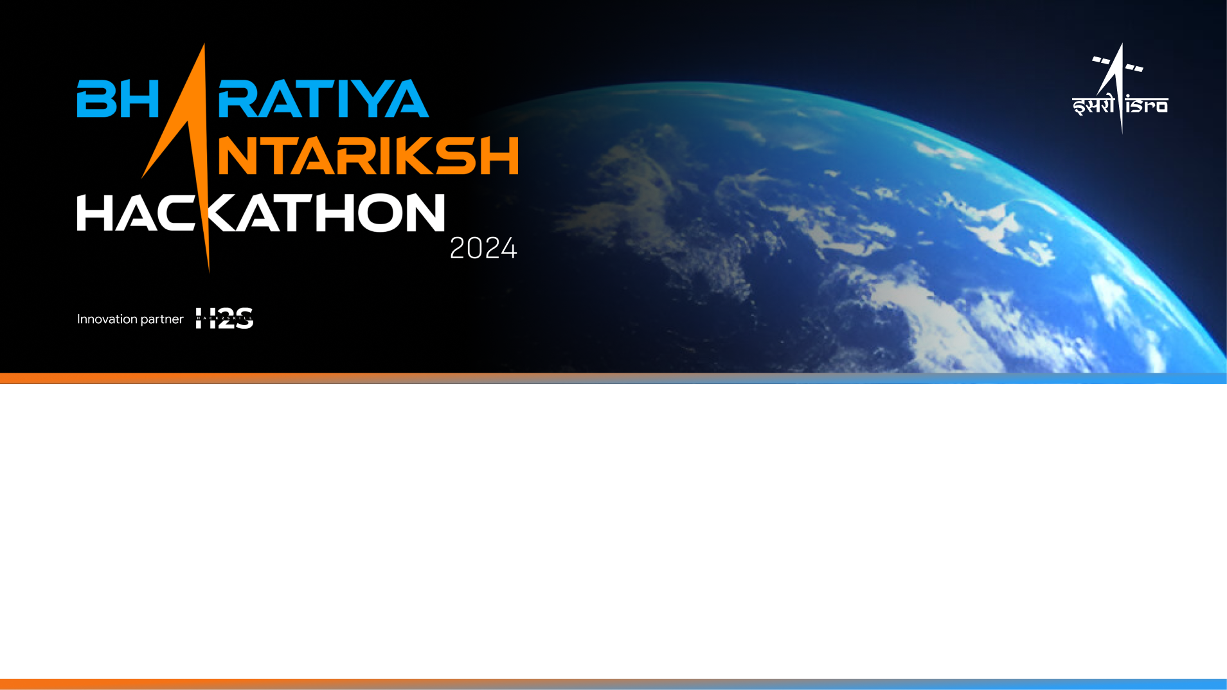
Team Name: Orbital Outliers
Name of College(s)/University(s): Academy of Technology
Team Members Details:
AMITAYU GHOSH
AKASHDIP MAHAPATRA
SUBHASISH DE
DHRUBA MONDAL

Slide 2
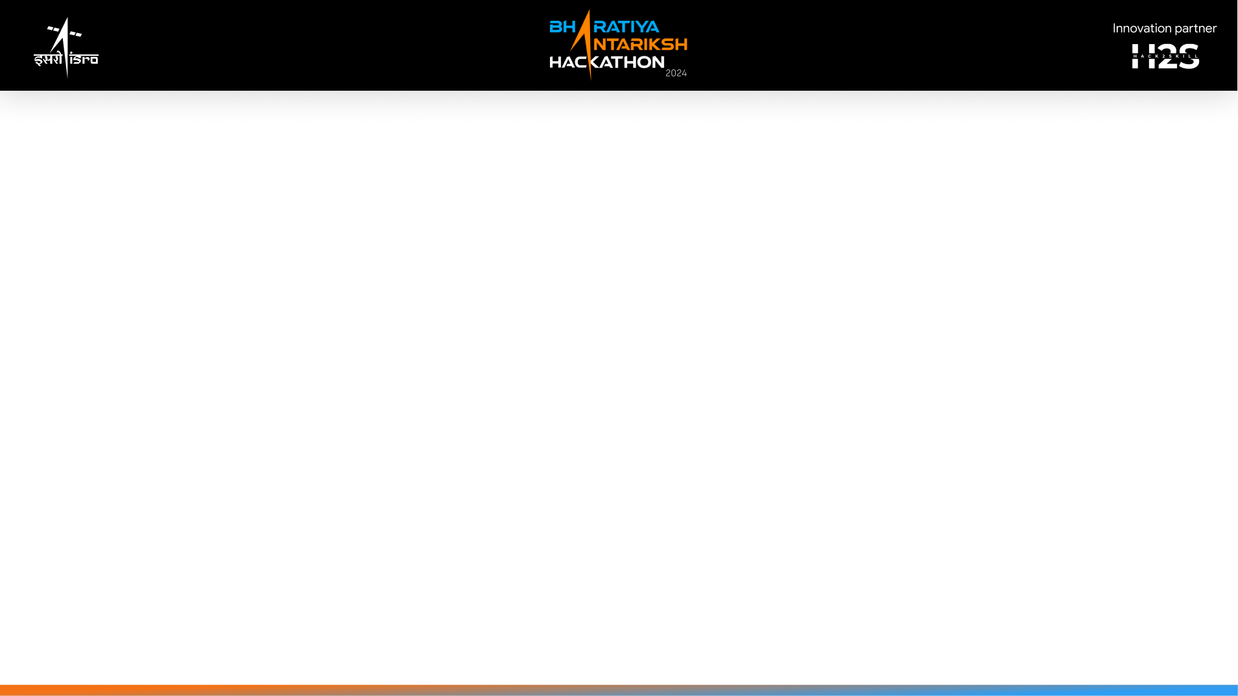
Detailed solution and Approach (250-300 words)
AI/ML model development for automatic detection of craters and boulders will be developed using a fine-grained approach with Orbiter High Resolution Camera
images through image processing and deep learning. The approaches described herein have the key steps as follows:
Image pre-processing: A step of OHRC image pre-processing will selenoreference images using the provided side information. This step will correct geometric
distortions and registration with respect to a common Lunar reference frame.
Model Training: One can use a Convolutional Neural Network architecture, such as U-Net, which is designed for image segmentation tasks. It will be trained
based on labeled datasets whereby craters and boulders are annotated. In this case, the model will learn features corresponding to craters and boulders of
different shapes and dimensions.
Data Augmentation: Robustify the model by applying the following data augmentation techniques: rotation, scaling, and contrast adjustment to simulate other
illumination conditions and views.
Detection and Quantification: The locations and boundaries of craters and boulders will then be predicted in new OHRC images by the trained model. Apply
post-processing techniques in refining these predictions in order to filter out false positives.
Selenographic Position and Dimension Calculation: Implement an algorithm that will calculate the selenographic coordinates and diameters of the detected
craters and boulders. This includes converting the pixel coordinates from the segmented images into lunar coordinates.
Shape File Generation: Generate a polygonal shape file or any other form of geospatial data format containing the boundaries and associated attributes,
namely size and position, of the detected craters and boulders.
Evaluation: By evaluating the model on test cases, check the accuracy with precision, recall, and F1-scores by comparing the features it detected against a
manually labeled validation set.

Slide 3
Tools and Technology Used (50 words)
Programming Languages: Python, C, C++
Libraries: TensorFlow/PyTorch (for deep learning), OpenCV (for image processing), GDAL (for geospatial data
handling), Keras and Shapely library for creating and manipulating shapefiles, Matplotlib and Seaborn for data
visualization and model evaluation
Software: QGIS (for shape file handling and visualization)
Data Formats: Polygonal shapefiles for crater/boulder boundaries
Image Processing Techniques: Edge detection, morphological operations

Slide 4
Opportunity should be able to explain the following:
How different is it from any of the other existing ideas?
How will it be able to solve the problem?
USP of the proposed solution
Most of the existing methods for crater detection are based on conventional image processing techniques that have limited performance in cases of
varying illumination and complex terrain conditions. In this paper, we put forward a more advanced deep learning technique tailored for the purpose of
crater and boulder detection to handle a diversity of shapes, sizes, and lighting conditions more robustly and accurately. This gives a holistic solution,
adding data augmentation and learning transfer with universal applications under different conditions, unlike the current models, which might be
applicable only to specific shapes or sizes of craters.
By applying state-of-the-art AI/ML models with a Deep CNN architecture, our solution is capable of automatically and accurately detecting craters and
boulders, hence reducing the need for manual annotation, therefore accelerating the analysis process. Deep training on different datasets efficiently
identifies craters and boulders with different characteristics. Furthermore, polygonal shapefiles and geospatial tools facilitate accurate mapping that
enables geospatial analysis, and it is because of this that the output in the above magnitude becomes quite actionable to researchers.
Our solution stands out in its sophisticated ability to automatically detect, measure and classify craters as well as boulders on OHRC images. It's able
to perform well with several different shapes and sizes - almost no matter their illumination conditions, giving accurate selenographic positioning
accuracy as well. This detailed, globally consistent and computationally compatible data set will improve the scientific good of lunar geologic maps for
serial exploration missions by contributing through more accurate and relevant datasets to what is known about the nature of surface materials on
Mare Tranquillitatis.

Slide 5
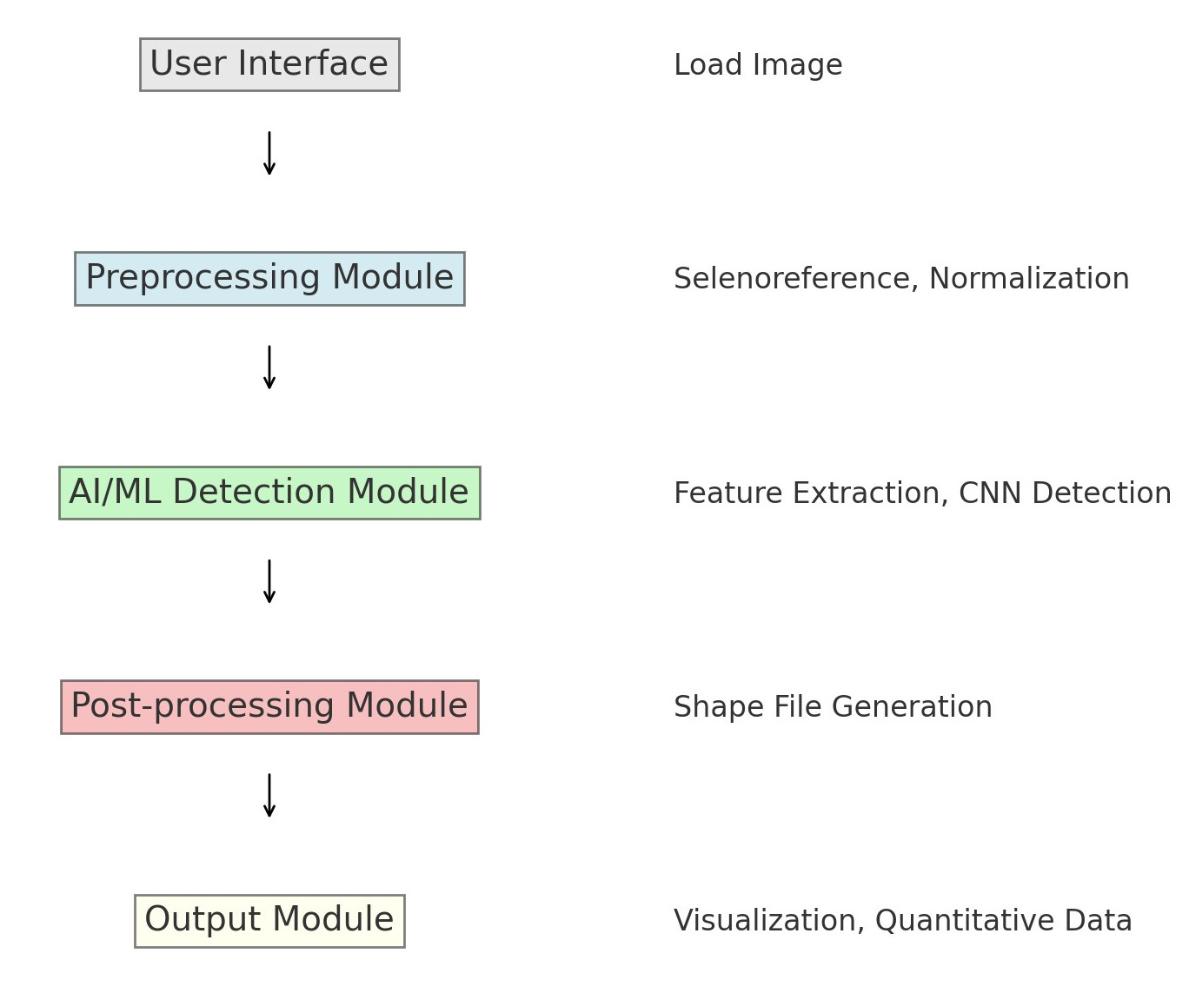
Proposed architecture/user diagram

Slide 6
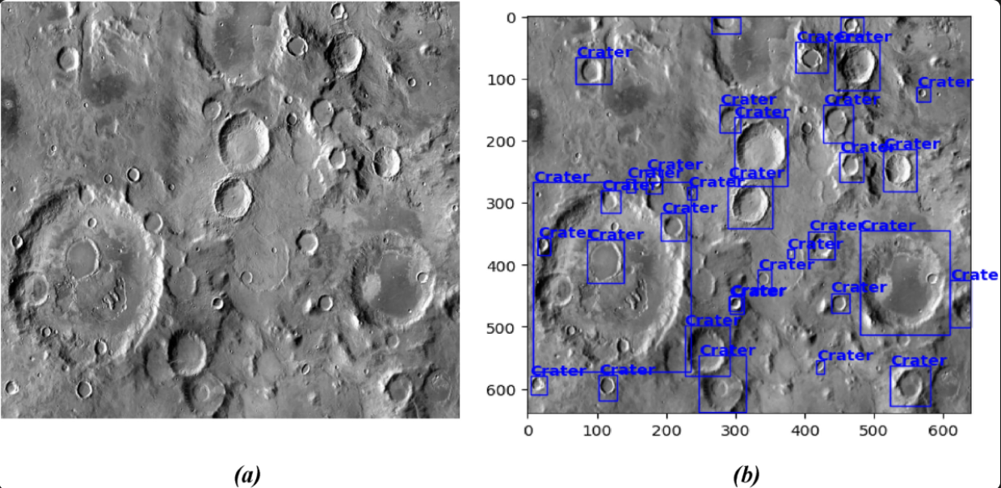
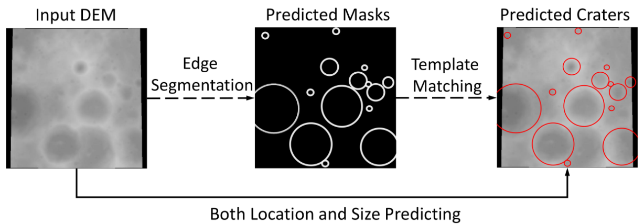
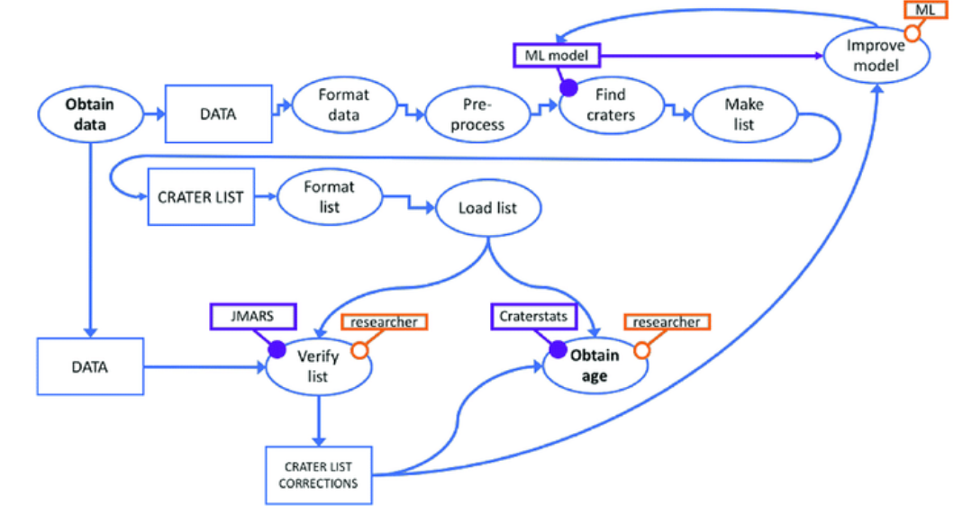
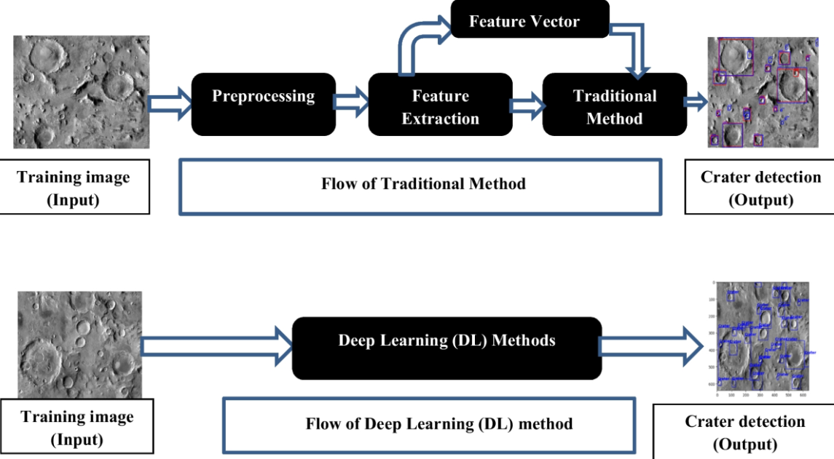
List of features offered by the solution

Slide 7
Process flow diagram or Use-case diagram
OHRC Dataset
Data Preprocessing Module
Training Subset
Training Subset
Deep Learning Module
Crater/Boulder Detection
Shapefile Generation Module
Shapefile with Crater/Boulder Information

Slide 8
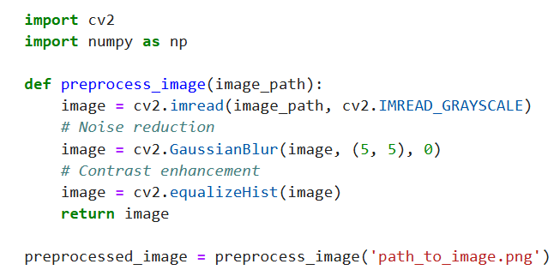
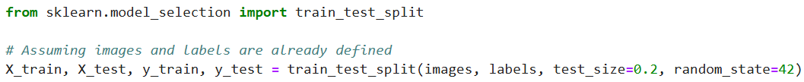
Data Preprocessing Module
Start
Read Image
Convert to Grayscale
Noise Reduction
Contrast Enhancement
Image Normalization
Segmentation
End
Training and Testing Subset

Slide 9
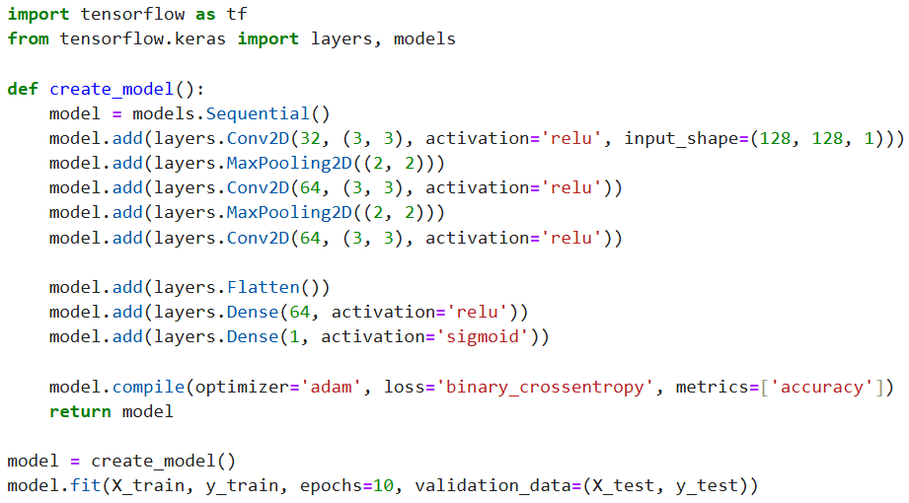
Deep Learning Module

Slide 10
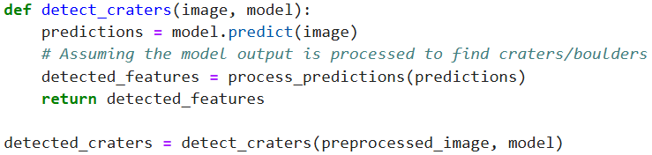
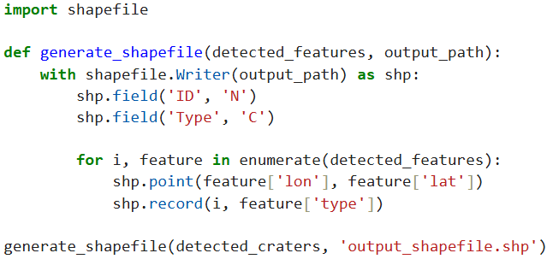
Crater/Boulder Detection
Shapefile Generation Module

Slide 11
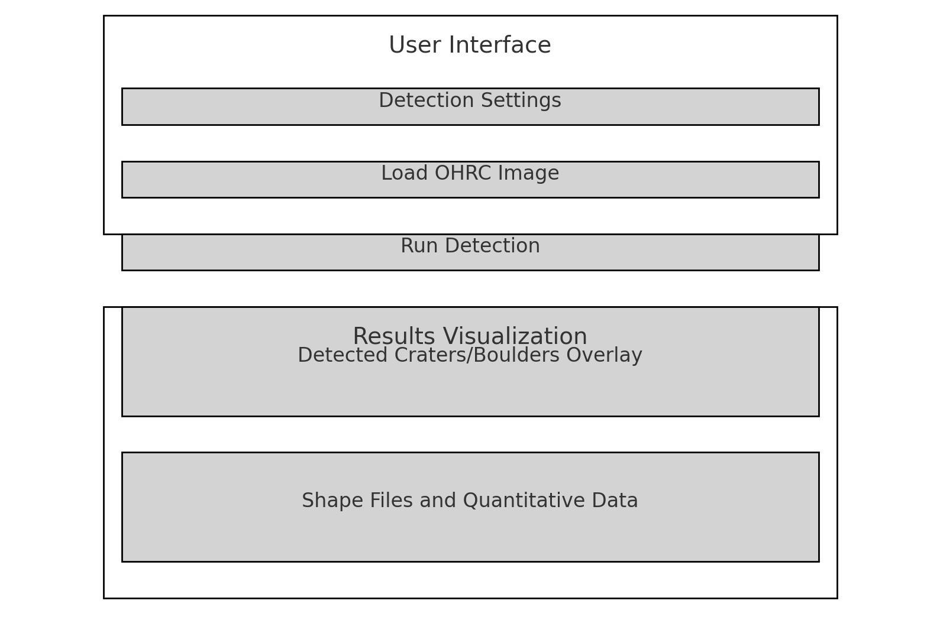

Slide 12
Solution Brief (Overall)
The automatic detection of craters and boulders in Orbiter High Resolution Camera (OHRC) images is crucial for planetary exploration and mapping. Utilizing
AI/ML techniques can significantly enhance the analysis of these high-resolution images.
Steps in the Solution
Data Collection and Preprocessing
Data Collection: Gather diverse OHRC images.
Annotation: Manually label a subset for ground truth.
Data Augmentation: Increase dataset diversity with techniques like rotation, scaling, and flipping.
Model Selection
Convolutional Neural Networks (CNNs): Use CNNs like U-Net, Mask R-CNN, or YOLO for feature extraction and object detection.
Transfer Learning: Fine-tune pre-trained models (e.g., from ImageNet) on OHRC images to reduce training time and improve performance.
Feature Extraction
Multi-scale Analysis: Capture both large craters and small boulders using multi-scale CNN architectures or image pyramids.
Texture and Shape Analysis: Utilize edge detection and Hough Transform for identifying circular shapes of craters.

Slide 13
4. Model Training
Supervised Learning: Train the model using annotated images, employing loss functions like Intersection over Union (IoU) for accurate localization.
Regularization Techniques: Prevent overfitting with dropout, batch normalization, and data augmentation.
5. Model Evaluation
Metrics: Use precision, recall, F1-score, and IoU to evaluate model performance.
Cross-Validation: Apply k-fold cross-validation to ensure generalization to unseen data.
6. Post-processing
Noise Reduction: Refine detections and reduce false positives with morphological operations.
Clustering: Use algorithms like DBSCAN to group detected features meaningfully.
7. Deployment
Scalable Infrastructure: Deploy the model on scalable cloud infrastructure using frameworks like TensorFlow Serving or PyTorch Serve.
User Interface: Develop an interface for scientists to upload images, run detections, and visualize results, including features for manual validation.
8. Continuous Improvement
Feedback Loop: Implement a mechanism for users to annotate and correct detections, feeding this data back for continuous improvement.
Periodic Retraining: Regularly retrain the model with new data and annotations to keep it updated.

Slide 14
